Slide 1
Speaker Notes
This deck is part of “App Camp in a Box”, a set of material to accompany the App Camp labs in an in-person workshop.
Instructors are strongly encouraged to watch the App Camp videos and complete the labs before delivering or proctoring App Camp! https://aka.ms/app-camp
Instruct your students to do the labs at that same location – https://aka.ms/app-camp
⬇️ Don’t forget to check the speaker notes! ⬇️

Slide 2
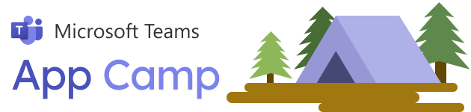

Anatomy of a SaaS Offer
Notes:
Recall that a monetized Teams application is a combination of an app in the Teams App store and a transactable SaaS offer.
In this presentation, we’ll walk through components of a transactable SaaS offer in the Microsoft commercial marketplace.
This will give you the understanding to get started building your SaaS offer and the resources to understand technical details at an even deeper level.
You’ll review these concepts in the monetization lab in Teams App Camp.

Slide 3
What we’ll cover
About SaaS offers
Using Partner Center
Purchasing a SaaS offer
SaaS offer landing page
SaaS offer publisher portal
Notes:
We’ll start with an overview of SaaS offers, then look at the setup in Partner Center.
Then we’ll show how you’d test the purchase of your offer in App Source via a test feature in Partner Center.
Then we’ll review samples of a landing page – the page you would provide to provision a newly purchased subscription – and of a publishing portal – which is a site you provide to manage subscriptions and licenses for your customers. Microsoft provides a starting solution called SaaS Accelerator that you can use as the basis for these features and we’ll be looking at screen shots from that solution.

Slide 4

About SaaS offers
A Software-as-a-Service offer type in the Microsoft commercial marketplace
Can provide underlying functionality of a Teams app
The billing vehicle for your Teams app offer
Notes:
SaaS offers are a type of offer within the Microsoft Commercial marketplace.
These are specifically for Software as a Service products, as compared with other kinds of offerings such as Azure Virtual Machines or Dynamics 365 apps.
The SaaS offer is the billing vehicle for your Teams app – it’s what you’re selling in the Teams App Store or Microsoft App Source.

Slide 5





Components of SaaS applications
Required
Partner Center
configuration
Landing Page with AAD SSO
Webhook
Licensing
service
Optional
Automated
provisioning
Automated
cleanup
Publisher
dashboard
Notes:
To create your SaaS offer, you begin by creating and configuring the offer in a web site called Microsoft Partner Center. This includes a lot of business information as well as some technical settings that we’ll review in a moment.
Then you’ll need a landing page, where the commercial marketplace can send users when they complete a purchase. This page can be hosted anywhere and written with any technology, but it does need to implement Azure AD Single Sign-on. Note that the Commercial Marketplace has a somewhat different definition of Azure AD SSO than Teams; Teams requires using specific API’s to provide a completely seamless login, whereas the Commercial Marketplace really just requires you to provide an Azure AD login where buyers of your application can log in with their regular credentials within their Microsoft Azure AD tenant.
You’ll also need to implement some web hooks, which are notified of changes to subscriptions, such as a cancellation or credit card problem.
Finally, if you’re using per-user licensing, you need to have some kind of licensing service. Many ISV’s already have a licensing service they can use; others will need to implement something that enforces licensing according to whatever rules you have defined.
There are also some optional areas.
It’s a really good idea to provide some kind of publisher dashboard so you can manage subscriptions in your own back-end and using the Commercial Marketplace API.
And while some ISV’s manually provision and clean up subscriptions (the landing page might just send an email to a human who sets up the services), automating these processes is a good idea.

Slide 6
Partner Center
Notes:
Section delimiter

Slide 7
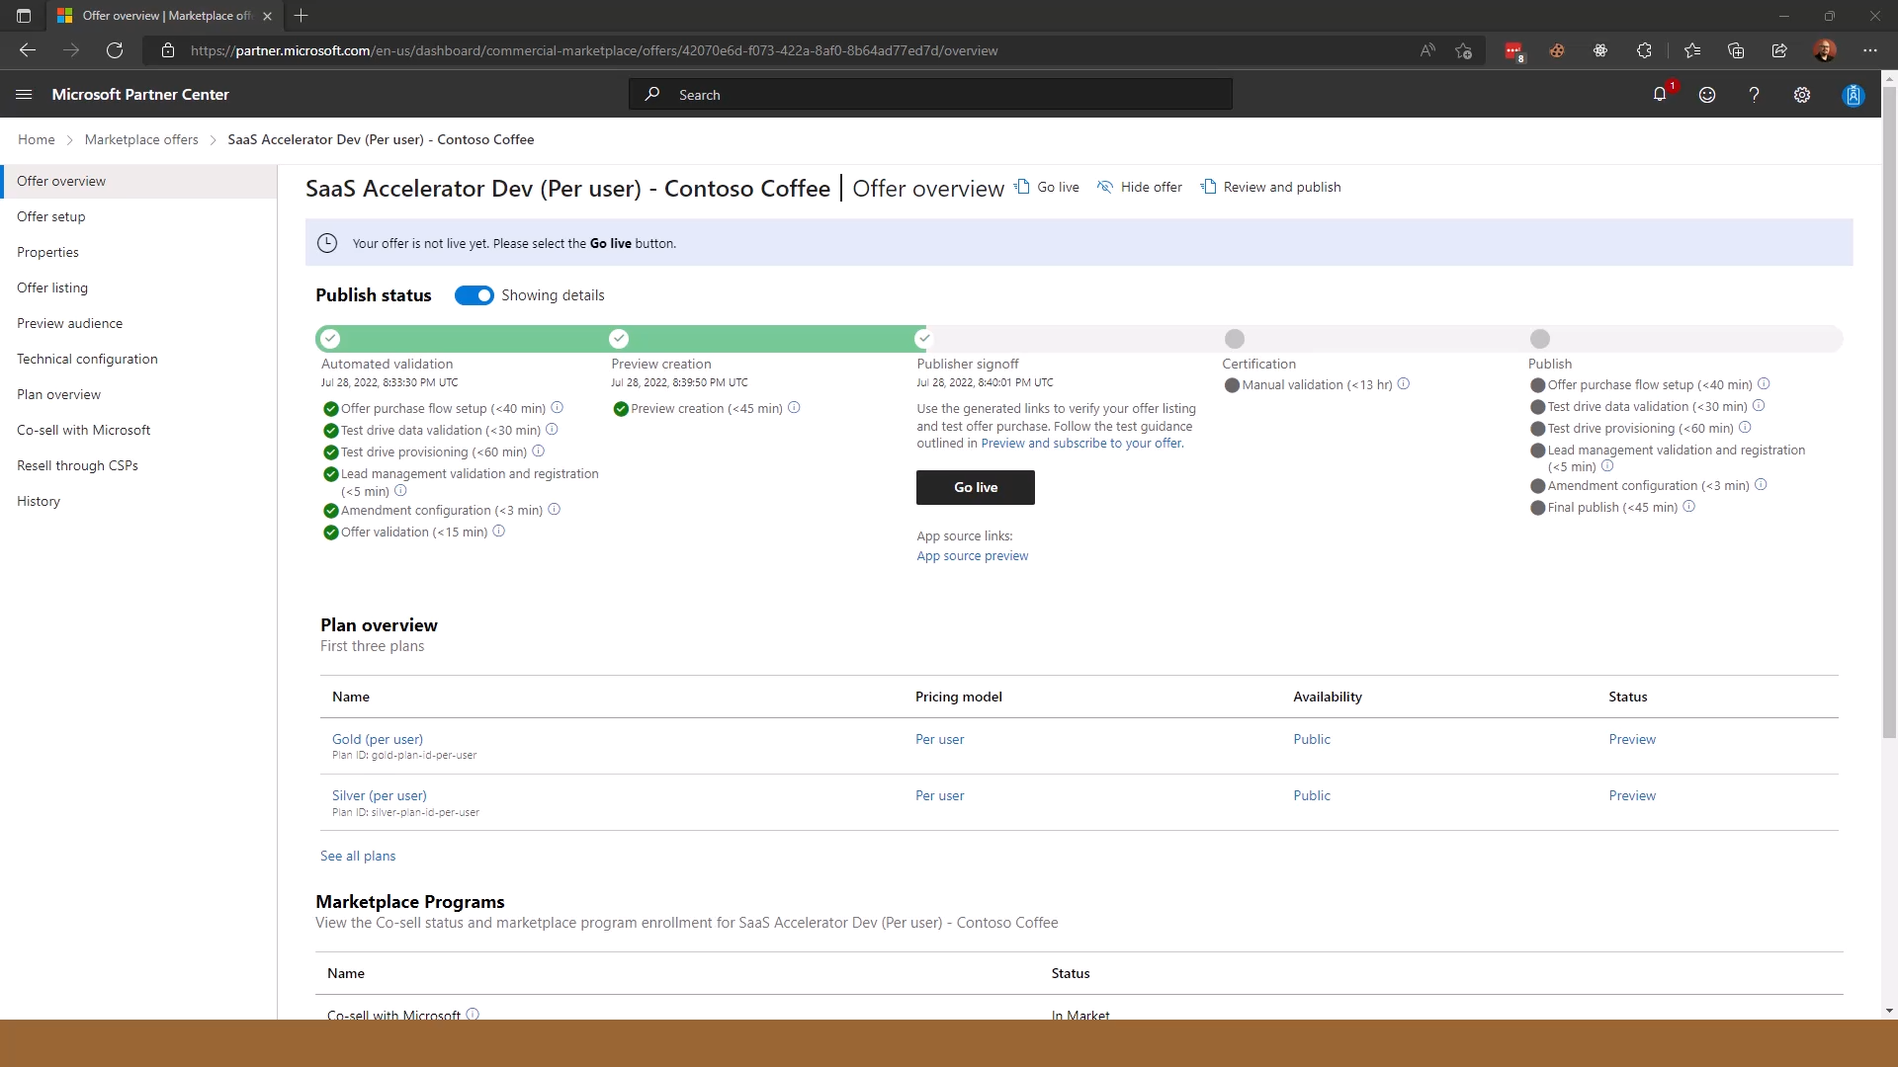
Notes:
This is a SaaS offer in Partner Center. This is where you set up and monitor the offers for your application.
Most of the information here is business related; for this presentation we’ll go into the Technical configuration.

Slide 8
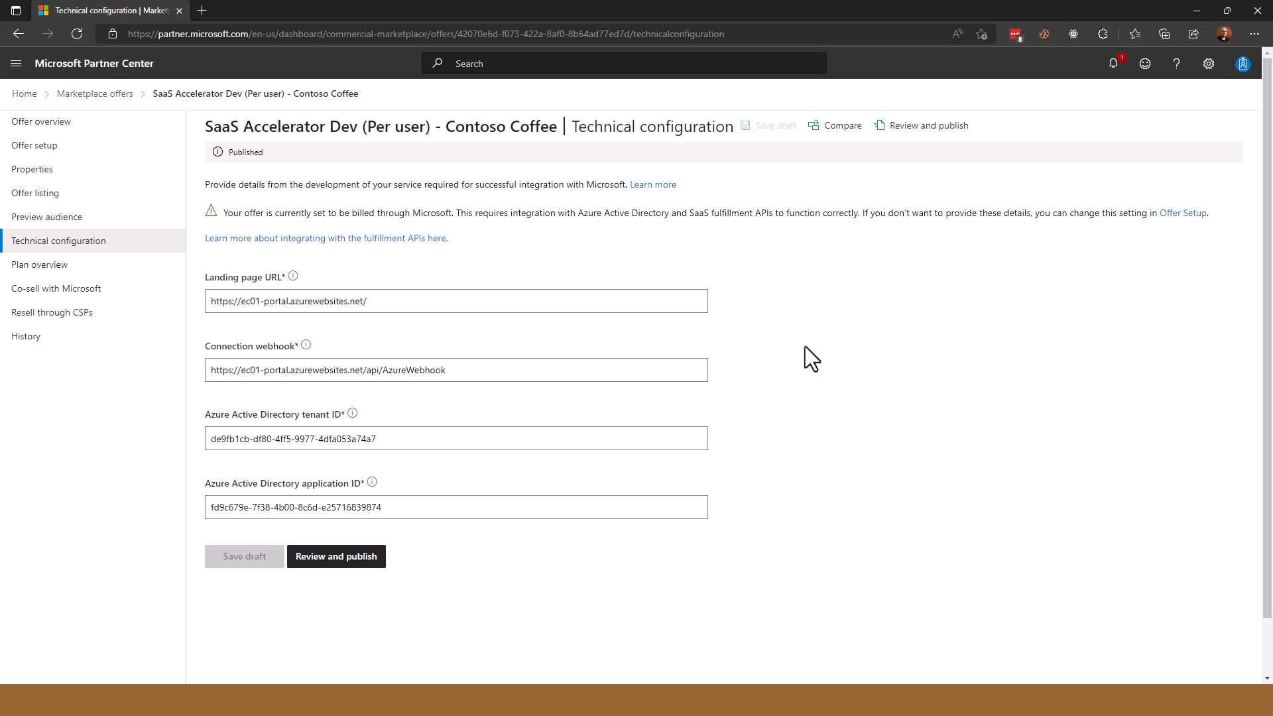
Notes:
This is where you set up the landing page and web hook URLs; note these don’t need to be in Azure.
You also need to include the tenant ID and app ID that your solution uses for Azure AD logins.

Slide 9
Purchasing a SaaS offer in AppSource

Slide 10
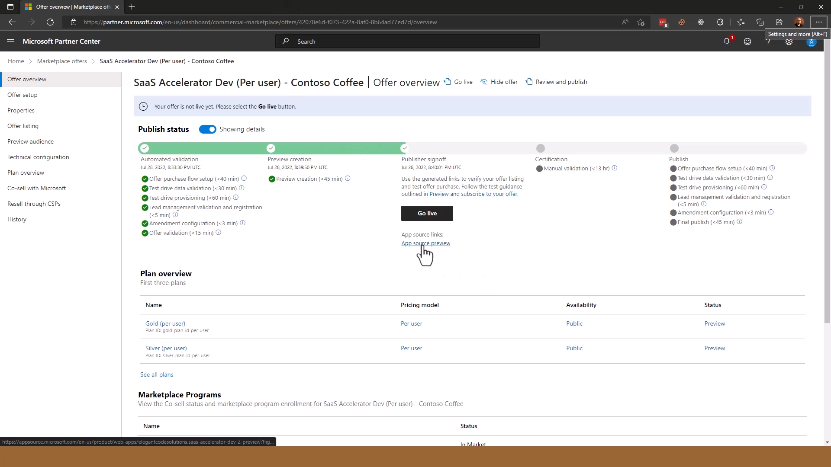
Notes:
Returning to the Offer Overview, we can preview the process of purchasing the SaaS offer from App Source.
Clicking App Source Preview brings you to the App Source page exactly as customers will see it.

Slide 11
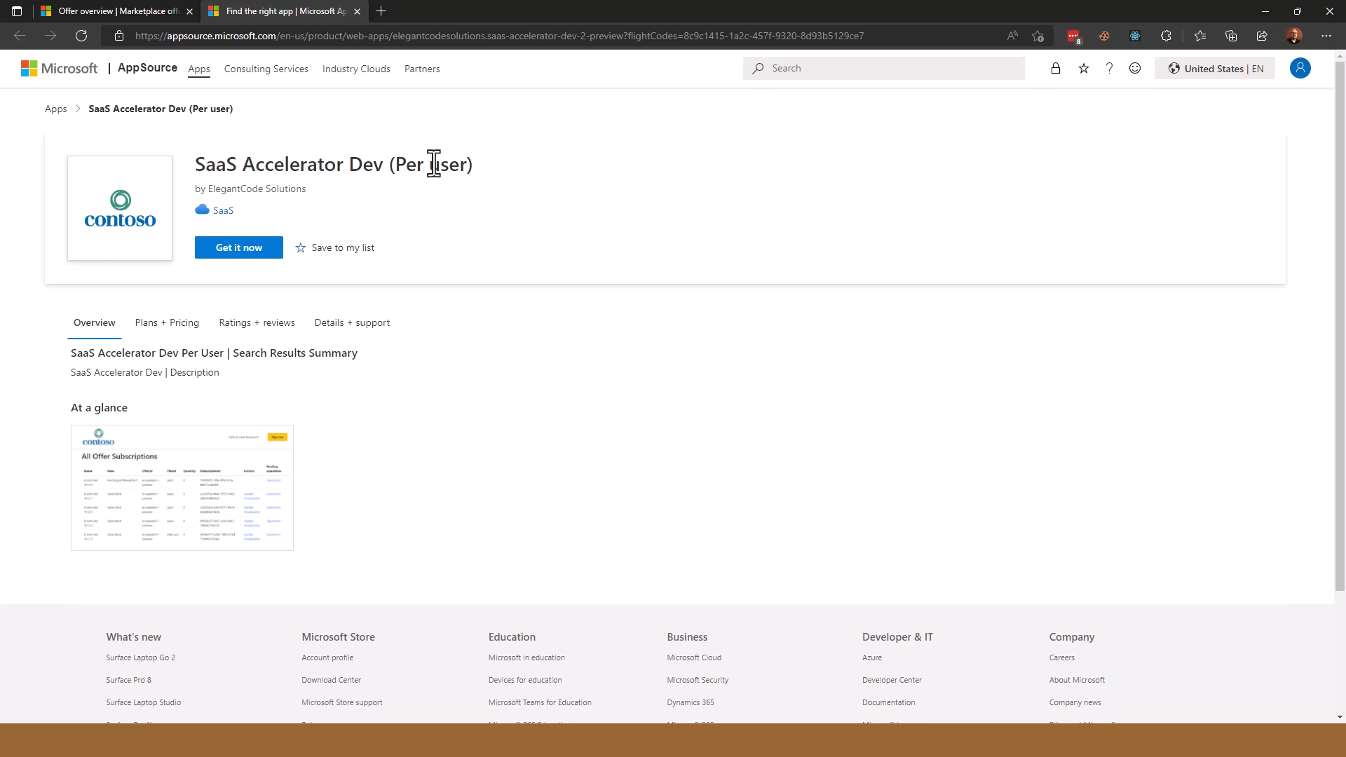
Notes:
Here you can view all the information about your app just as a user would see it.
By clicking “Get it now” we can purchase the offer.

Slide 12
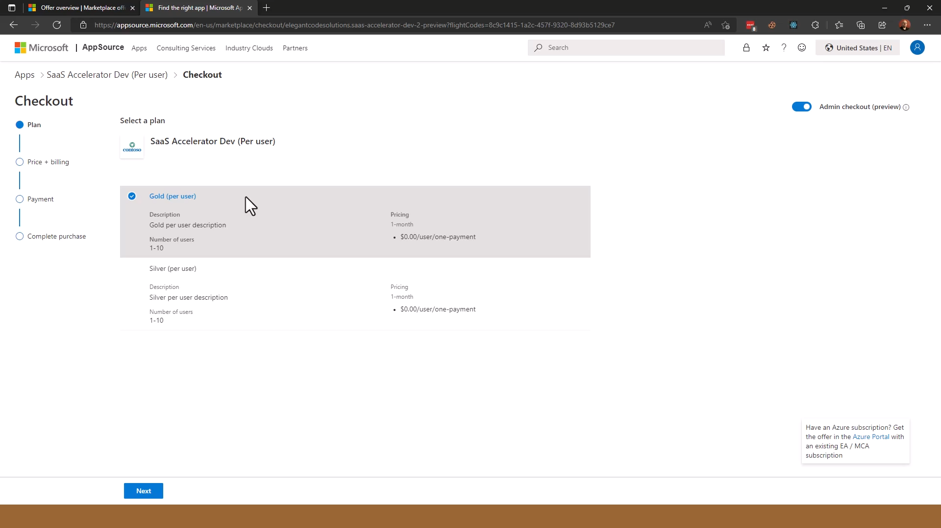
Notes:
Notice we’ve created two plans, Gold and Silver, for this offer. That’s something you would also do in Partner Center, with potentially different pricing and terms. Your product would cost more than $0/user of course.
Clicking Next we can proceed to fill in the billing terms.

Slide 13
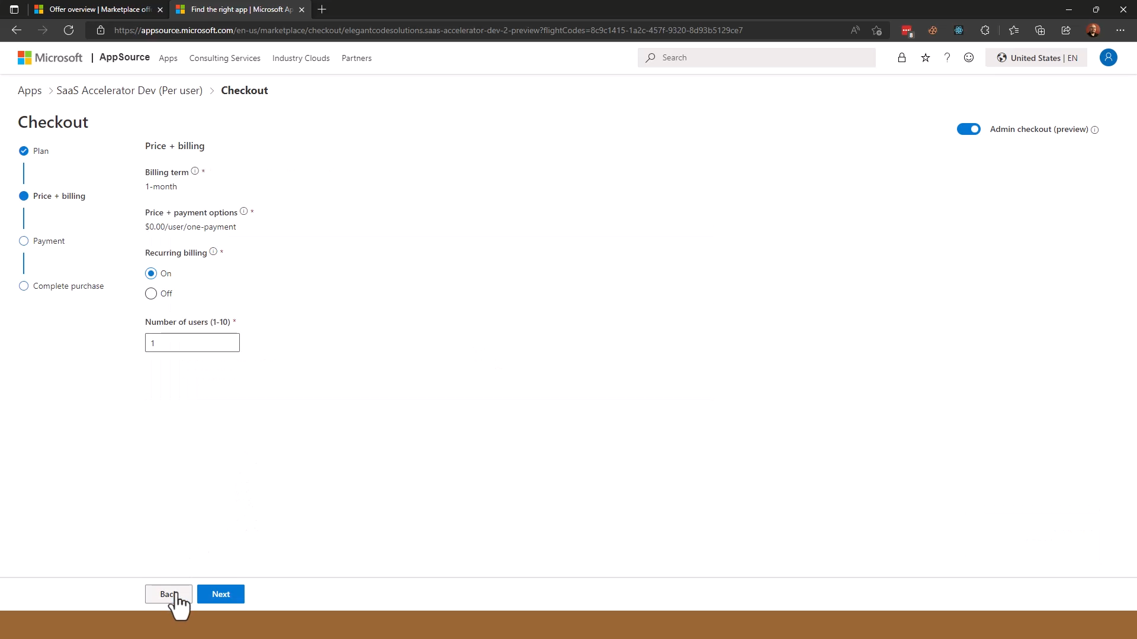
Notes:
Here we can select the terms such as the number of users and whether the purchase is recurring.
Clicking Next brings us to the checkout page.

Slide 14
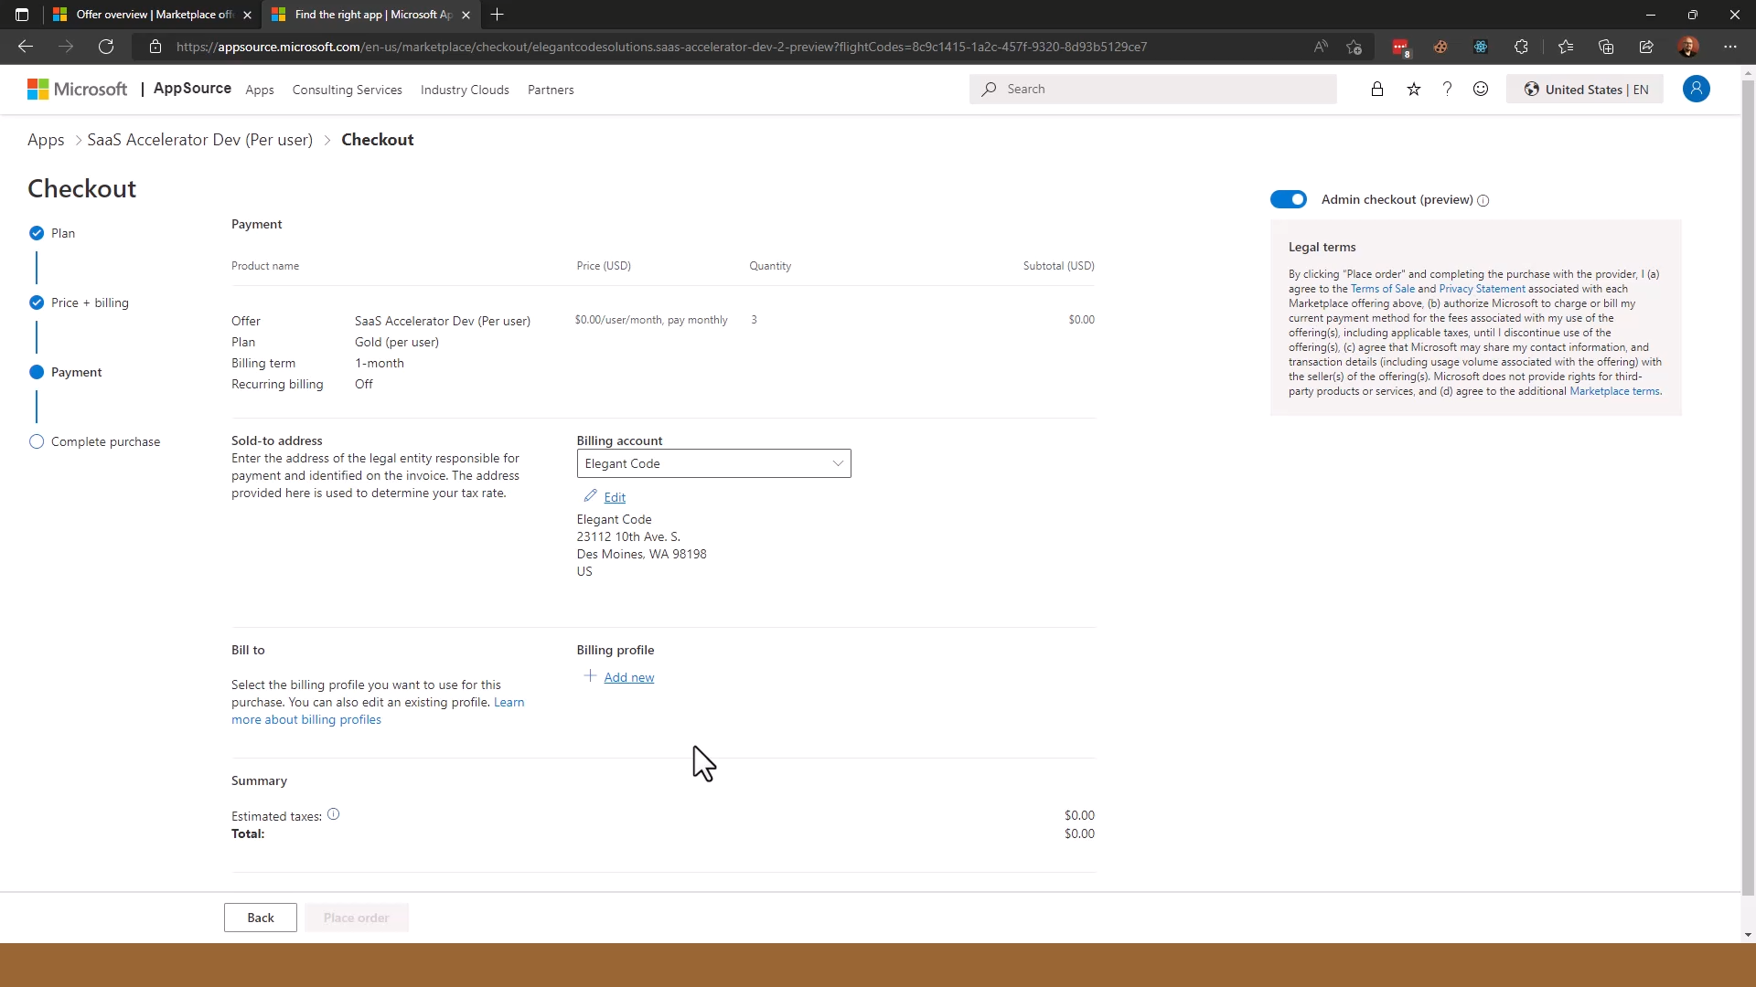
Notes:
Here we can fill in the billing details and actually make the purchase.

Slide 15
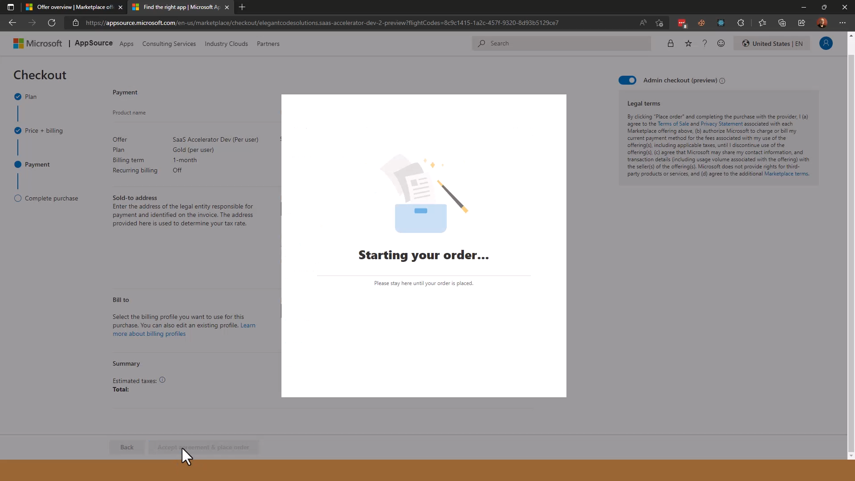
Notes:
It takes a moment for the commercial marketplace to complete the order.
This is the process of creating a subscription to the SaaS product.

Slide 16
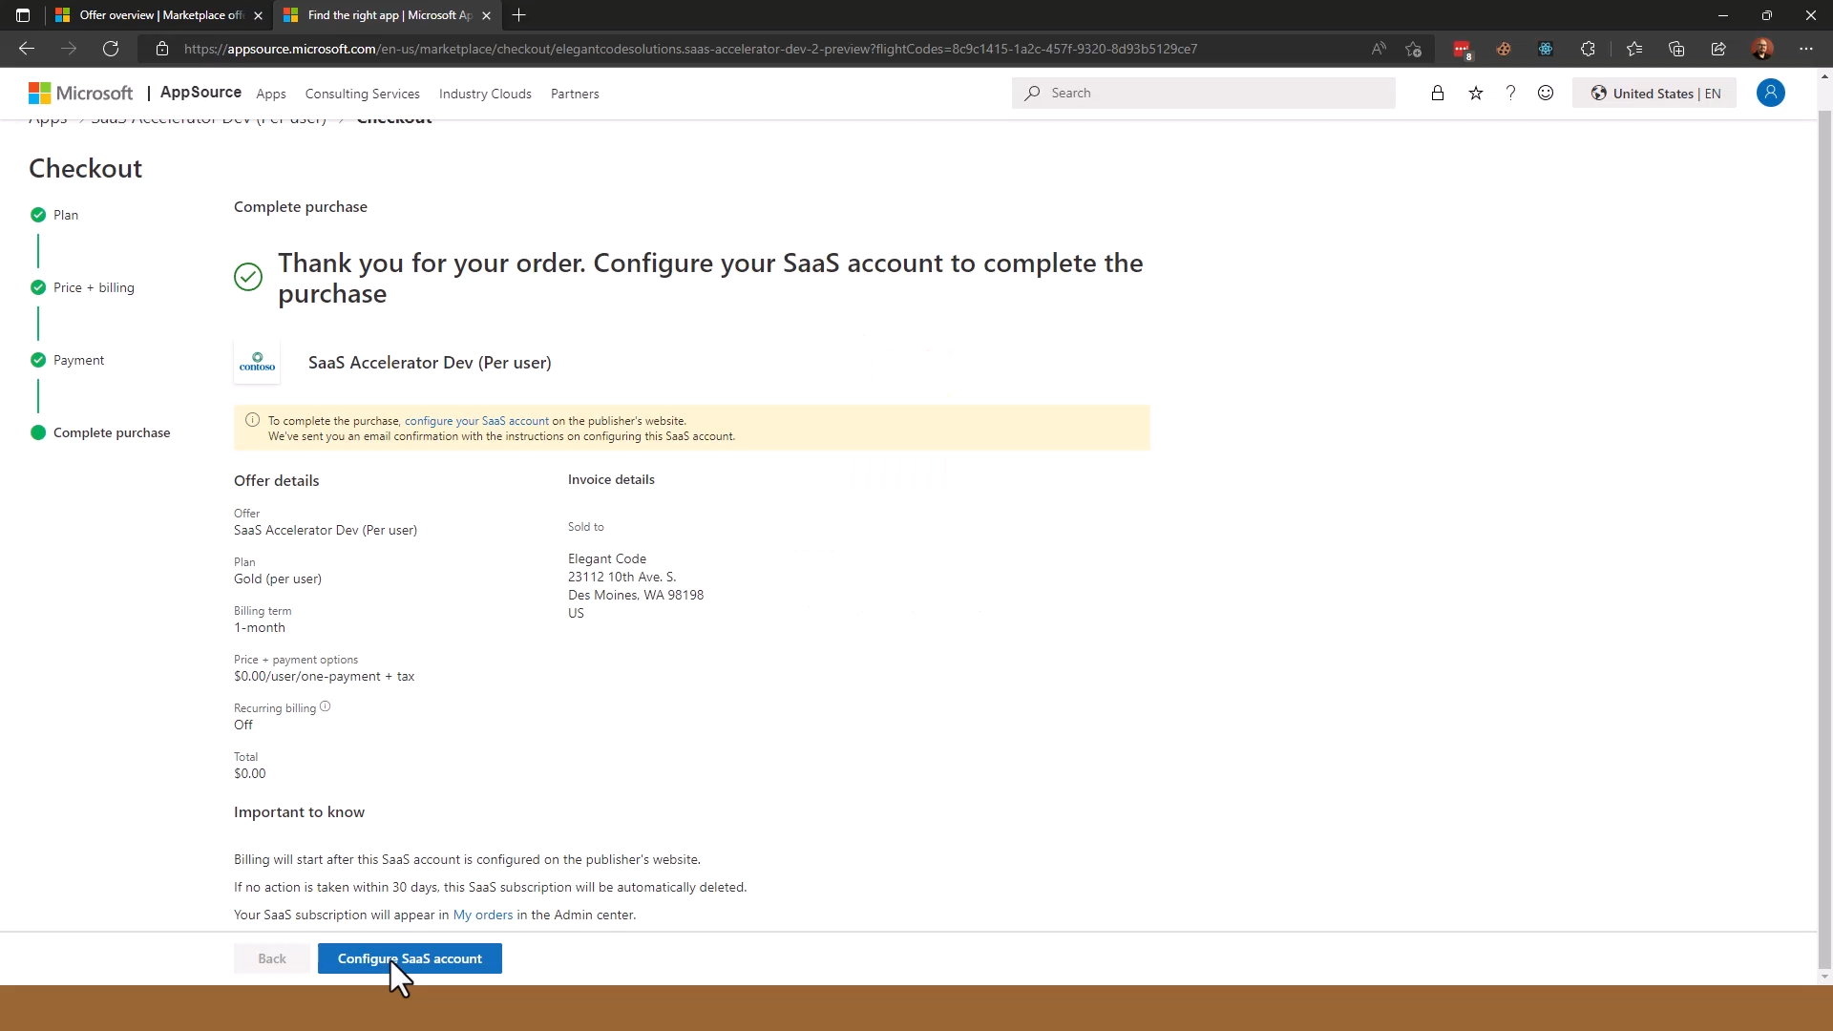
Notes:
Here is the order confirmation page. At this point, the user can click “Configure SaaS account” to set up their newly purchased subscription.
This brings them to your landing page, on which the customer can review what they have subscribed to.
Activating the subscription is another API call made by the publisher to begin billing.

Slide 17
SaaS offer landing page

Slide 18
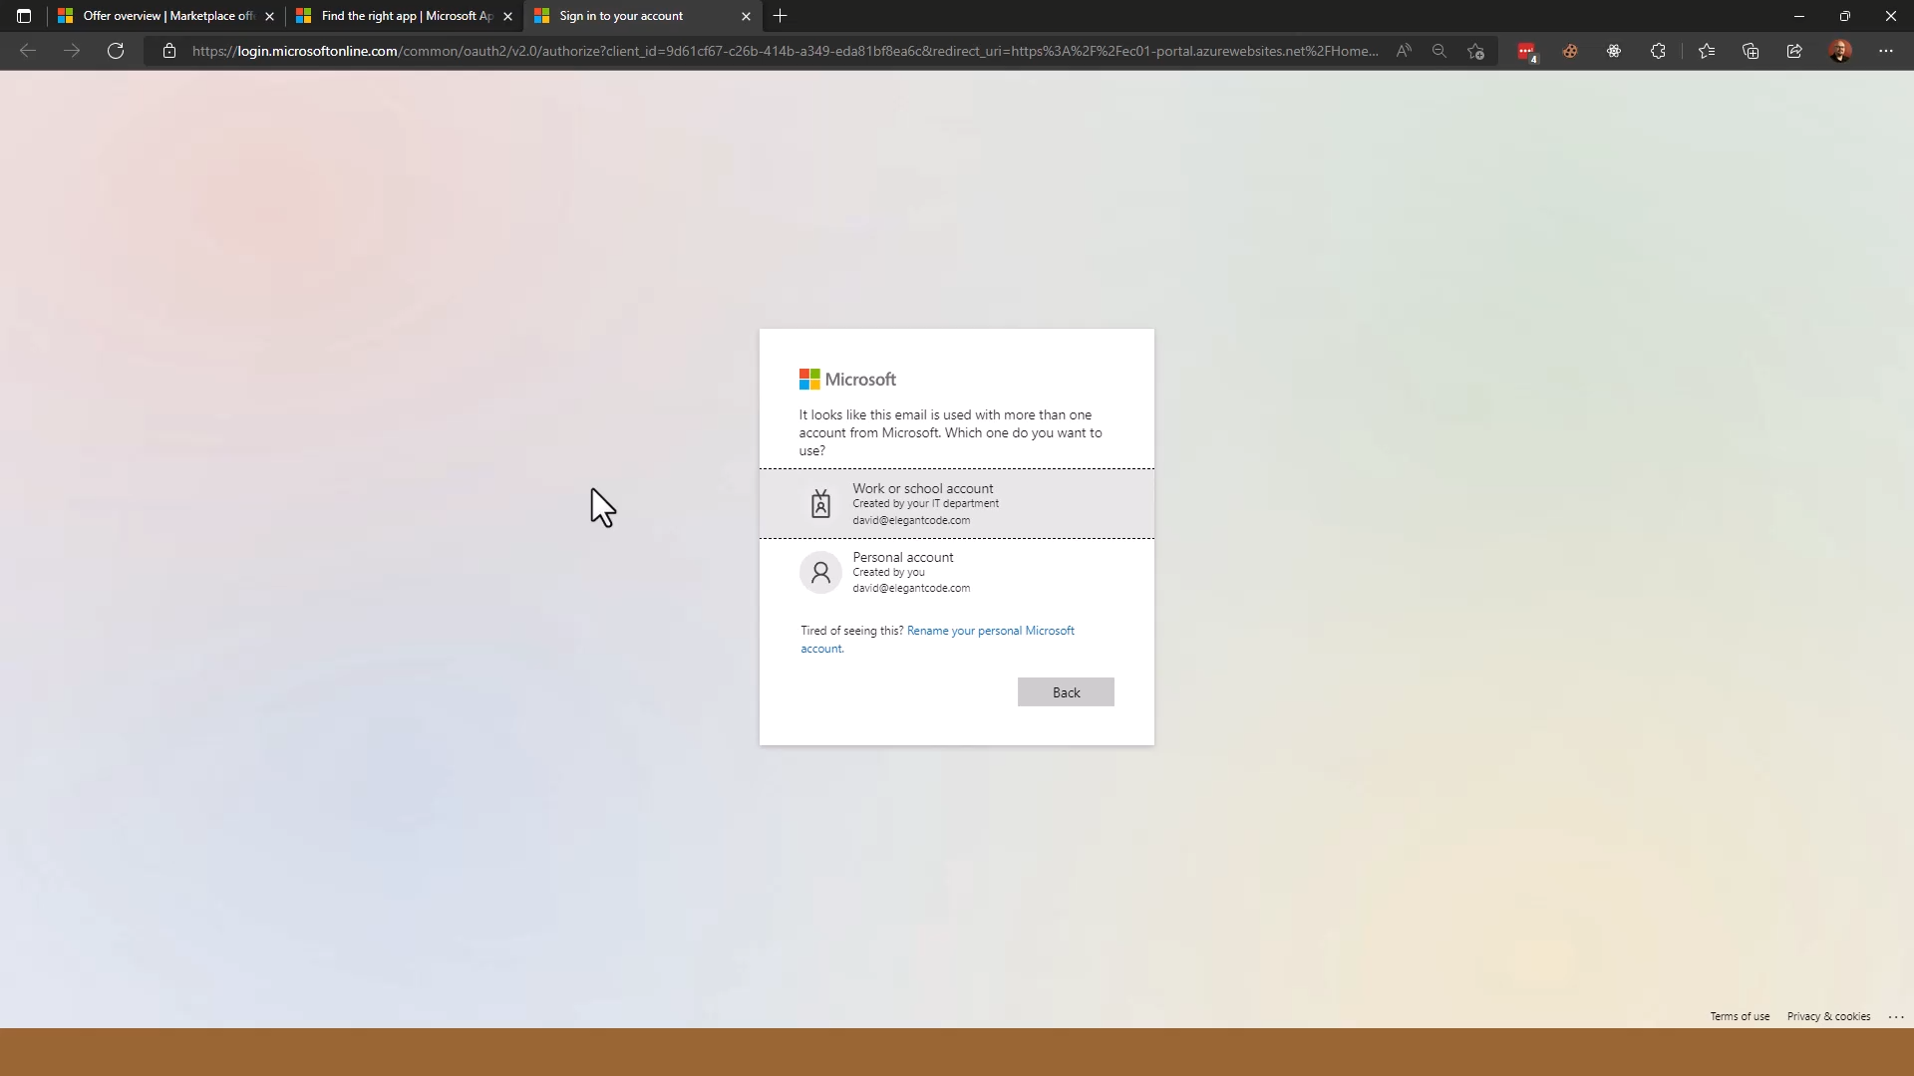
Notes:
Now the user is directed to your landing page. Your landing page needs to implement an Azure AD login; here we see the user logging in to Azure AD.

Slide 19
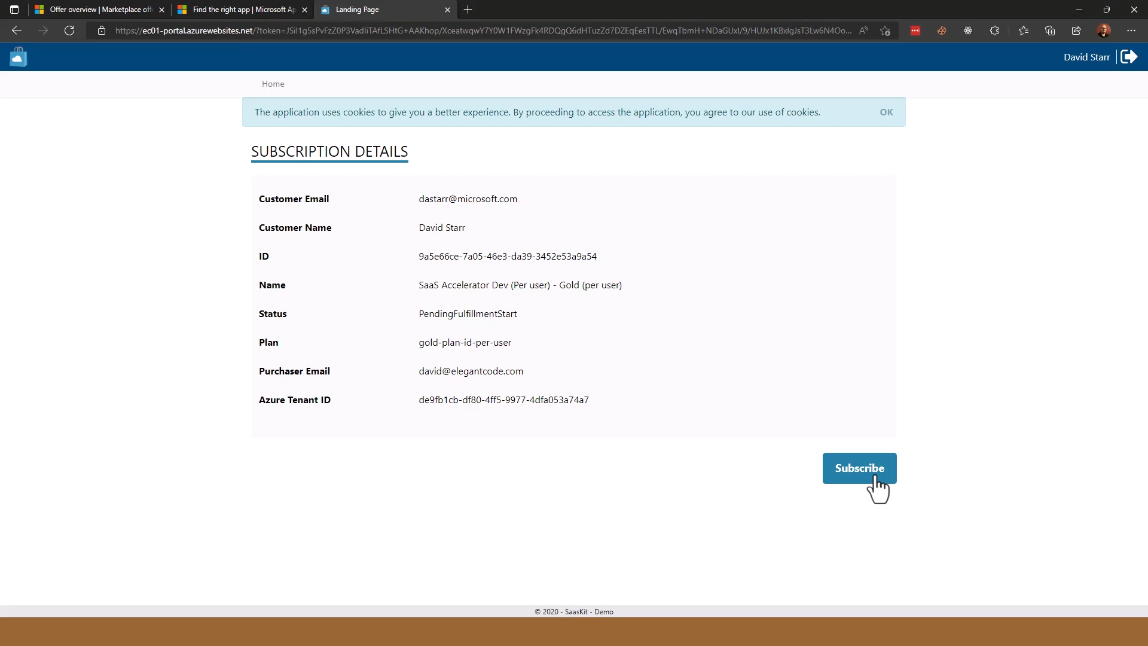
Notes:
Now the user has logged in (notice they have chosen to show the username in the upper left corner) the landing page can display the details of the subscription that was purchased. Notice that there is a long token in the URL; the landing page used this token to call the Commercial Marketplace API and retrieve the order details as shown centrally on the screen.
Here, the user can review the details once again and, if they’re correct, they can click Subscribe.
At that point, the landing page will confirm the subscription using the Commercial Marketplace API, and will request any other setup needed by the application. Perhaps this kicks off an automated process to configure the new subscription, or it could be as simple as sending an email to an administrator who would manually provision the new subscription.
This page, by the way, is the one included in the SaaS Accelerator starting application.

Slide 20
SaaS offer publisher portal (optional)
Notes:
This is optional but a really good idea as inevitably you’ll need to manage the subscriptions that were purchased.
The ISV is responsible for this but again, the SaaS Accelerator provides a starting point, which we’ll look at next.

Slide 21
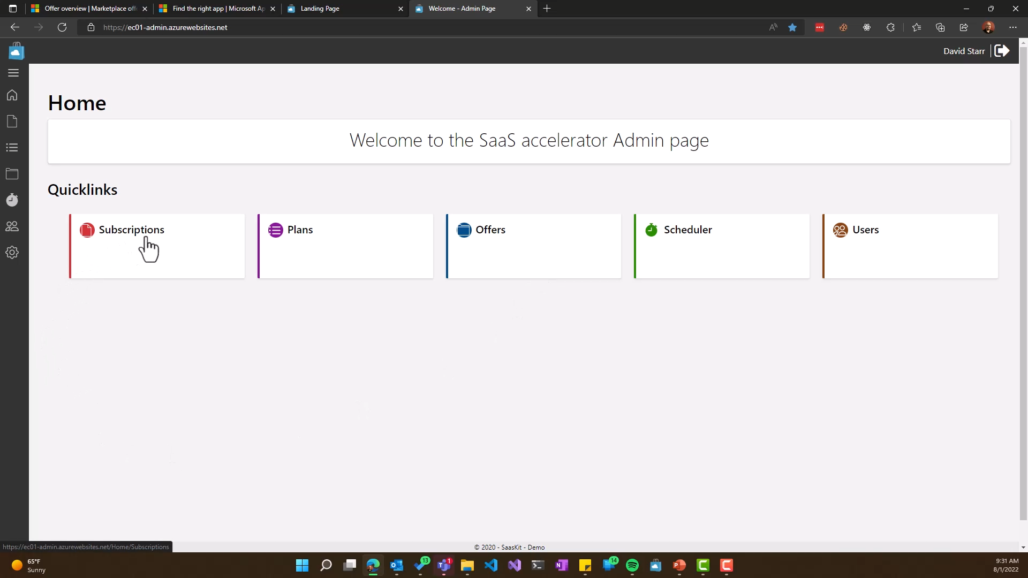
Notes:
Here is a sample publishing portal.
If the user clicks Subscriptions, we can see the subscriptions that were purchased.

Slide 22
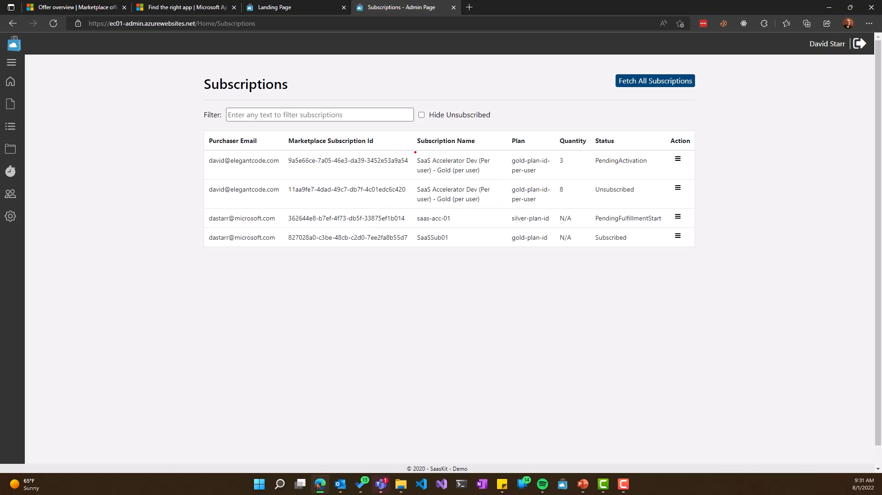
Notes:
Notice there is a new subscription – the one we just purchased – and it’s “Pending Activation”.

Slide 23
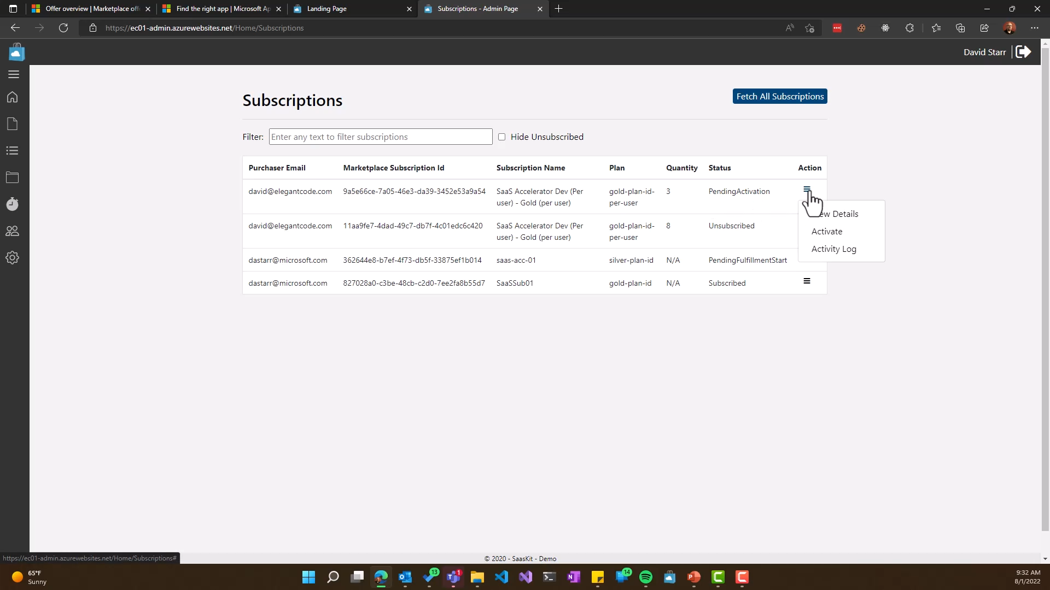
Notes:
Once the provisioning is complete – let’s assume it’s manual in this case – an administrator can select the “Activate” action within the “Action” menu.

Slide 24
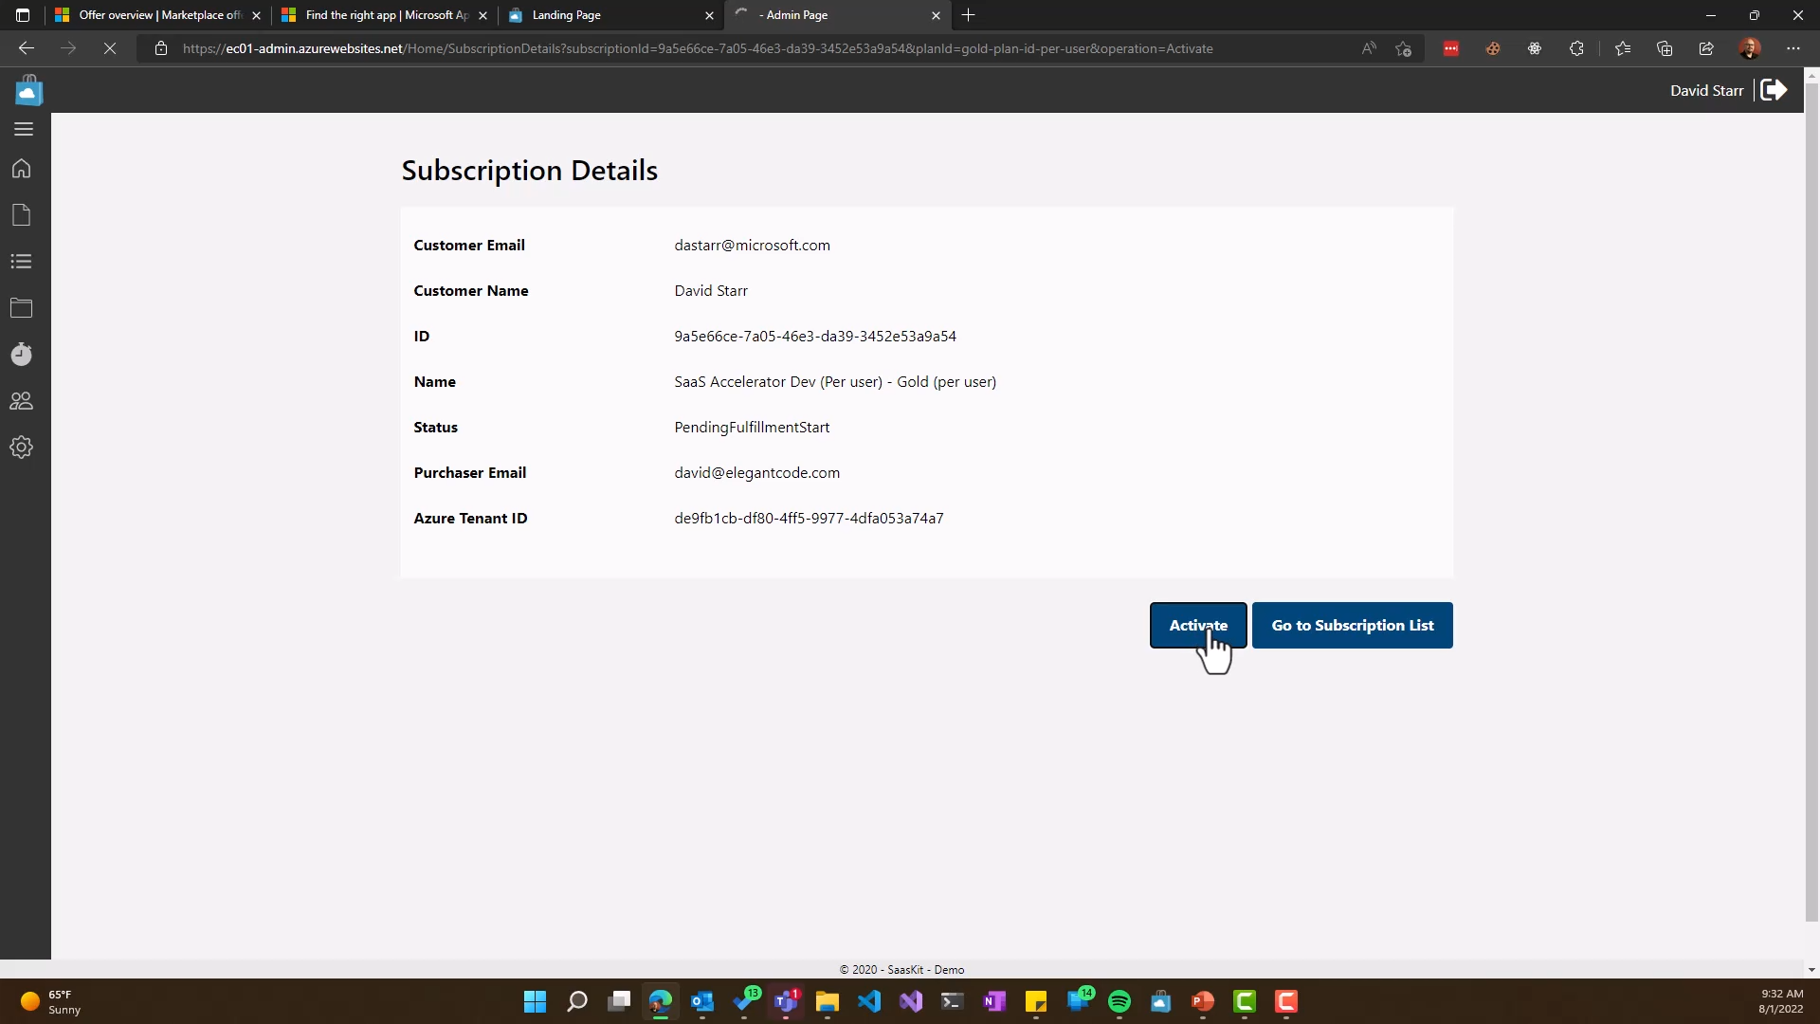
Notes:
Again there is a confirmation page; if the user clicks “Activate”, the portal will again call the Commercial Marketplace API to mark the subscription as active.

Slide 25

Notes:
Notice that now the subscription is marked as “Subscribed”

Slide 26
A licensing service is needed for per user pricing
Notes:
Now that a certain number of user licenses have been purchased, it’s up to your application to handle the assignment and enforcement of these licenses. This is entirely up to you, and many ISV’s already have a licensing service in place that provides this.
In the Monetization Lab you’ll connect the Northwind Orders app to such a licensing service, and you’ll walk through an App Source simulator to purchase a subscription. This will send you to a sample landing page and licensing service that will control access to the application. While you won’t write the landing page and licensing service, you will walk through the sample code to see how it works.

Slide 27
Components of a complete solution
AppSource
Teams App Store
Teams
Landing page
Webhook
Licensing service
SaaS app
Microsoft commercial marketplace provides
ISV provides
Notes:
To review, here are the components of a complete SaaS solution.
Microsoft provides App Source and the Teams App Store, which are configured using Partner Center.
You provide the landing page and web hooks, as well as a licensing service that works within your SaaS application.

Slide 28
Thank you
Learn more at https://aka.ms/MasteringTheMarketplace/saas
Notes:
If you’d like to learn a lot more about this, as well as the SaaS Accelerator starting solution, please visit https://aka.ms/MasteringTheMarketplace/saas.

